Slide 1
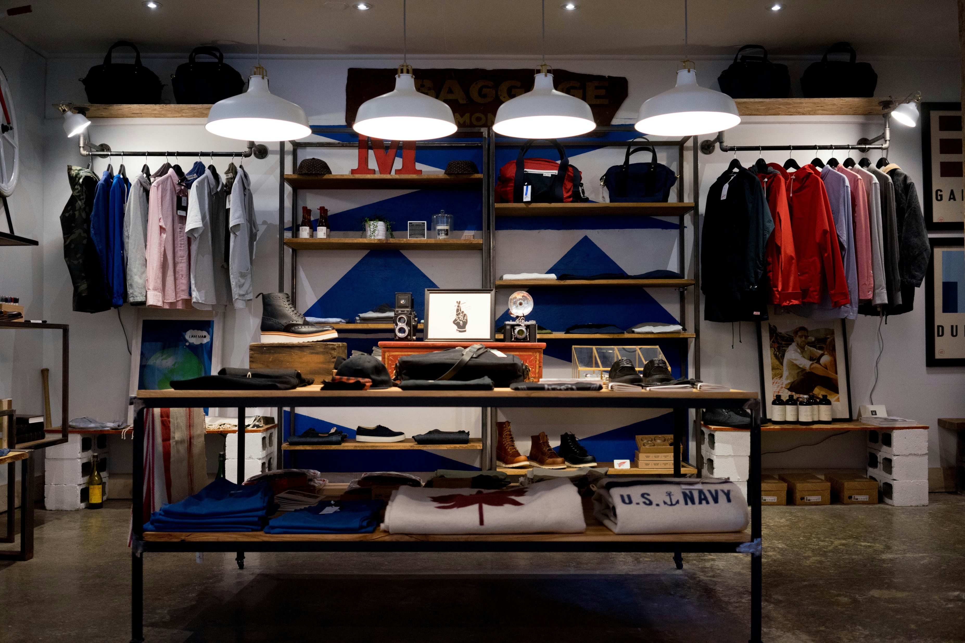
Product Data Analysis.

Slide 2
Table Contents
Entity Relationship Diagram.
Data Cleaning & Transformation.
Solving Questions Generated by ChatGPT -
10 Easy Level Questions.
10 Medium Level Questions.
8 Hard Level Questions.

Slide 3
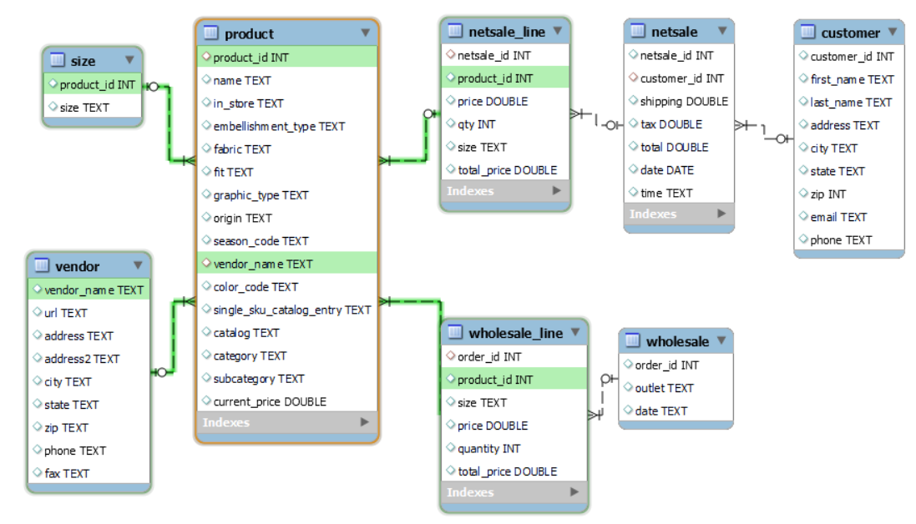
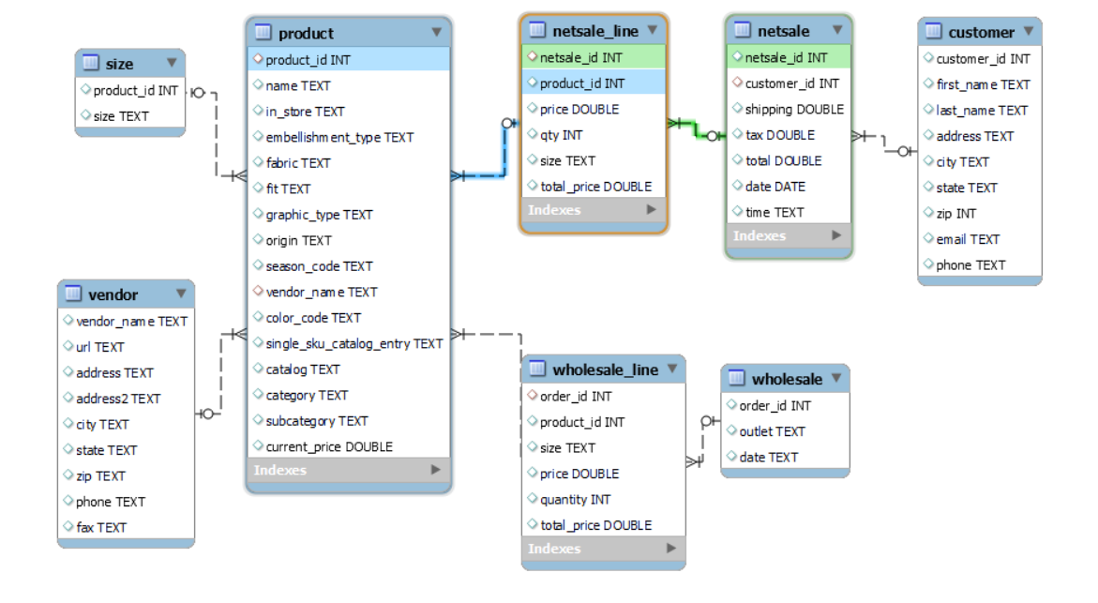
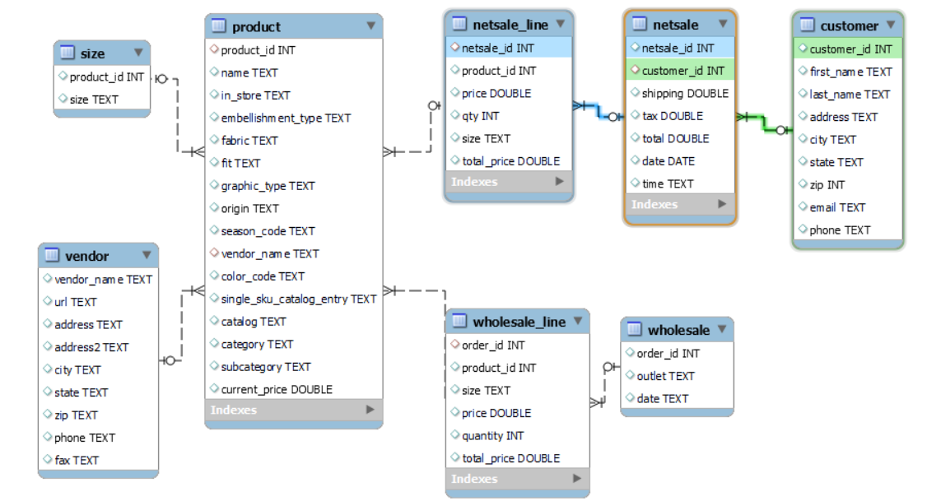
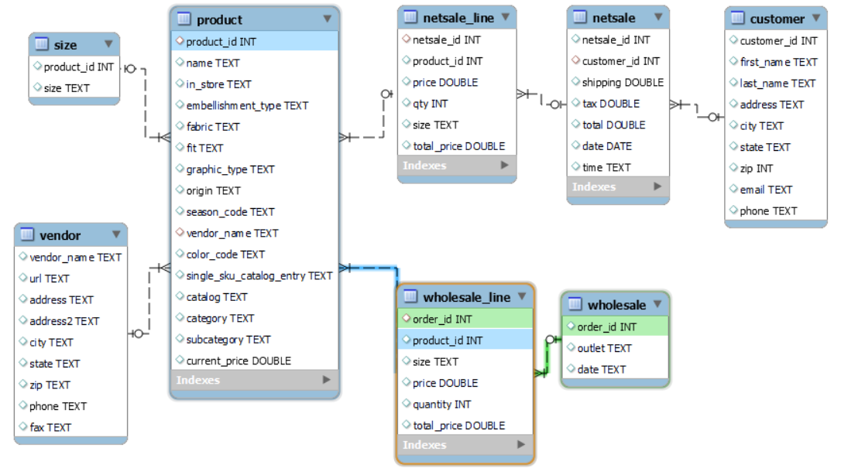
Entity Relationship Diagram

Slide 4
Data Cleaning And Transformation
Data Cleaning Of Customer Table
- Checking any null values using sum, coalesce, group by and having clause (No null values was present).
Negative sign in phone number attribute ,replaced by using trim and leading function.
Created New column which displays full name of the state rather then short name of the country which was difficult to understand. Data of the full name of the country is generated by ChatGPT. Created a csv file where short name and full name of the country was present and then imported to Product_Dataset_Analysis Schema.
Data Cleaning Of Netsale Table
Checking any null values using sum, coalesce, group by and having clause (No null values was present).
Seperating sale_time column into Date and time into 2 different column using str_to_date() and substring_index() function
Data Cleaning Of Netsale Table
Checking any null values using sum, coalesce, group by and having clause (No null values was present in netsale_id, product_id, price, qty).
18223 Null values was present in Size column (But did not deleted null values as the quantity of null values was more, also size varies for different customer, hence no changes in the column was made.
Create a new column Total_price which was multiplication of price and qty.

Slide 5
Data Cleaning Of Product Table
Checking any null values using sum, coalesce, group by and having clause (No null values was present in product_id, name and in_store column).
226 blank values in embellishment_type.
670 blank values in fabric.
1180 blank values in fit.
237 blank values in graphic_type.
157 blank values in origin.
1 blank value in vendor.
642 blank values in color_code.
769 blank values in single_sku_catalog_entry.
525 blank values in subcategory.
Choose not to drop blank values as it will lead to big loss of data.
- Cleaning Name Column and replacing ^un^,^,^ma^,^color^ signs with blank space
Data Cleaning Of Size Table
Checking any null values using sum, coalesce, group by and having clause (No null values was present).

Slide 6
Data Cleaning Of Vendor Table
- Updating city column , to full name using inner join function.
Data Cleaning Of Wholesale Table
Seperating time from date column
Data Cleaning Of Wholesale_line Table
- Creating new column total_price which is the multiplication of price and quantity.

Slide 7
Solving Questions Generated by ChatGPT
# Q1. How many products are currently in store?
Products in store
1099 Products
# Q2. What are the distinct embellishment types available in the product table?
Embroidered/Sewn
Screen Print
Tackle Twill Applique
Sublimated
Etched/Engraved
Other Embellishment
Decal
Felt Applique
Embossed
Special Print Process
Non-Emblematic/School Color
There are total 11 unique types of Embellishment types.

Slide 8
# Q3. How many different vendors are there?
Different Types of Vendors
94 Different Vendors
# Q4. What are the top 5 most common fabric types?

Slide 9
# Q5. How many unique sizes are available?
# Q6. What is the total quantity sold for a specific category?
79 different sizes are available in 2 categories which
are Clothing & Accessories , Gift & Collectibles

Slide 10
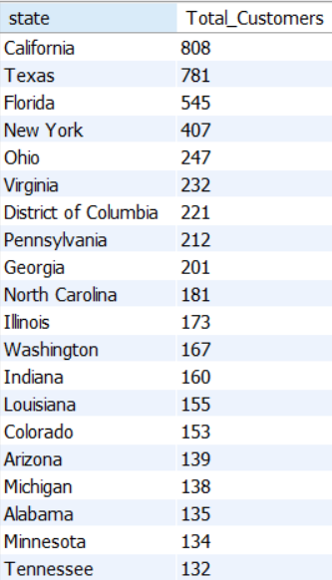
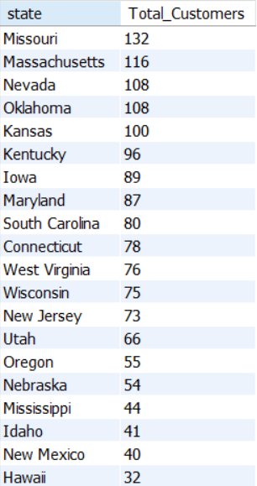
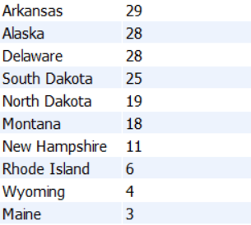
# Q7. How many customers are from different states in the customer table?

Slide 11
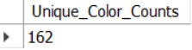
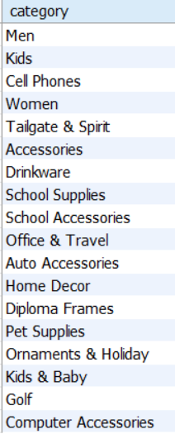
# Q8. What are the unique colors available in the product table?
# Q9.How many unique categories are there in the product table?

Slide 12
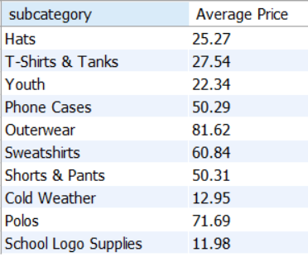
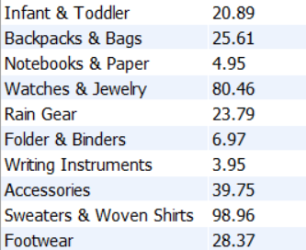
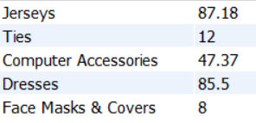
# Q10. What is the average current price of products by subcategory?

Slide 13
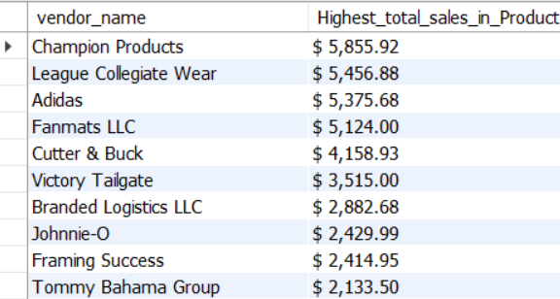
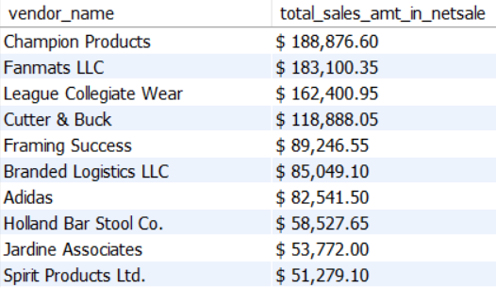
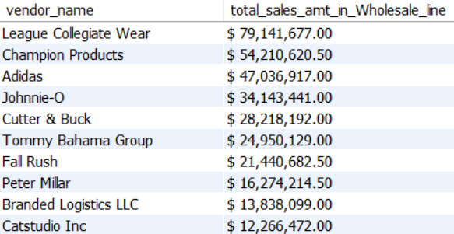
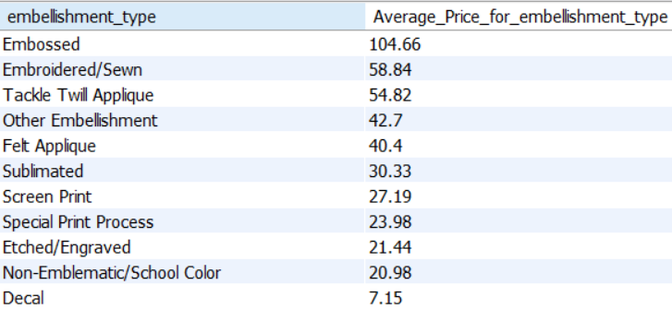
# 11. Which vendor has the highest total sales amount? (Top 10 from each category that is Product Category, Netsale_line Category, Wholesale_line Category)
Product Category
Netsale_line Category
Wholesale_line Category
# Q12. What is the average price of products for each embellishment type?

Slide 14
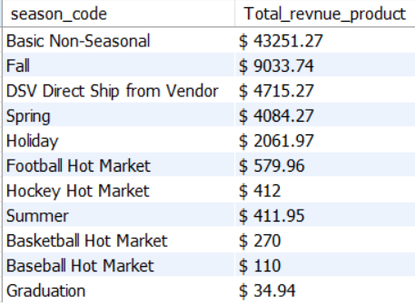
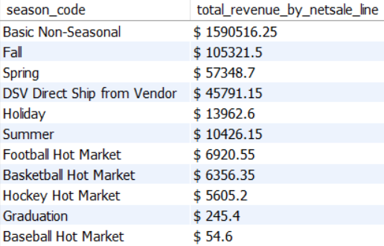
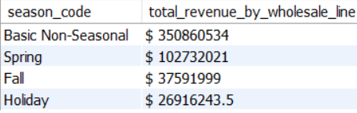
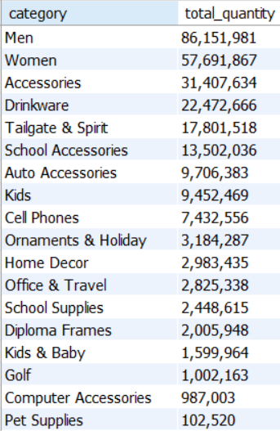
# Q 13. What is the total revenue generated from sales in a specific season?
Product Category
Netsale_line Category
Wholesale_line Category
# Q 14. How many products have been sold in each category?

Slide 15
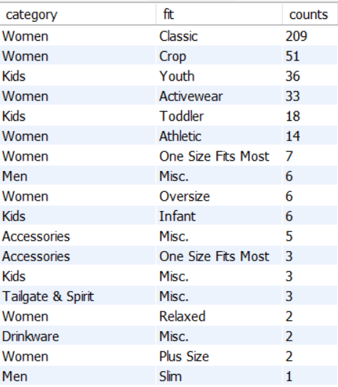
# Q. 15 What is the average total price of sales in each city?
There are total 457 different average prices for each city, some of the average prices which are highest in some cities are,
# Q 16. What is the most common fit type for each category?

Slide 16
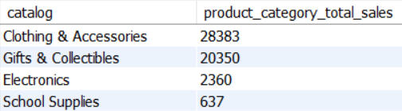
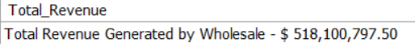
# Q.17 Which product has the highest total sales quantity?
# Q 18. What is the total revenue generated from wholesale orders?

Slide 17
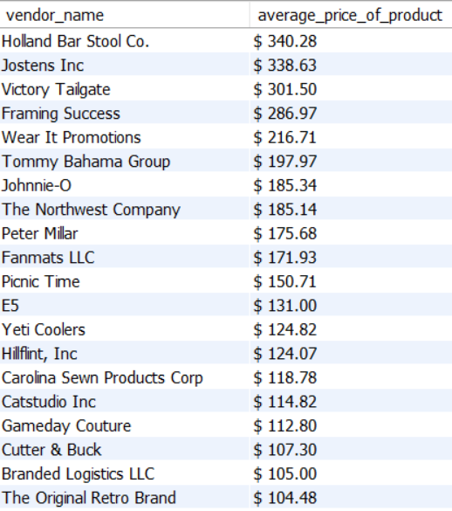
# Q 19. What is the average price of products for each vendor?
There are 98 different vendors who’s average price is different but the 20 vendors with highest average price are as follows,

Slide 18
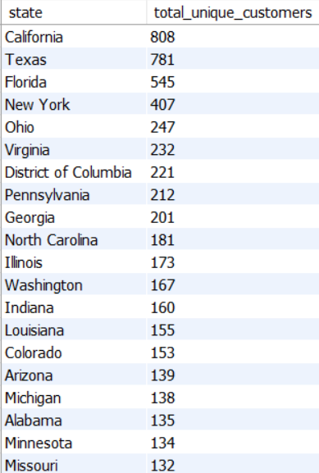
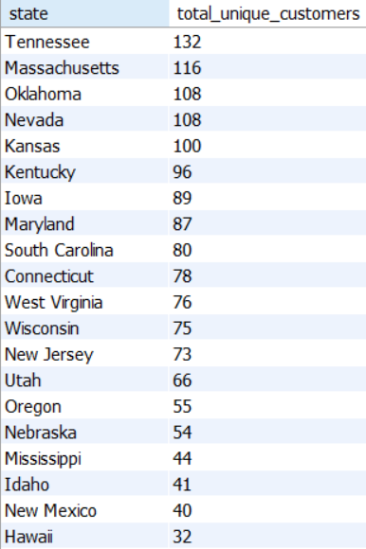
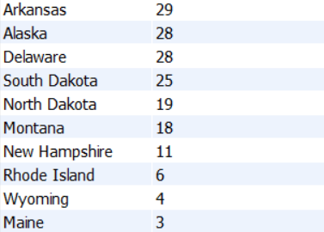
# Q 20. How many unique customers have made purchases in a specific city?

Slide 19
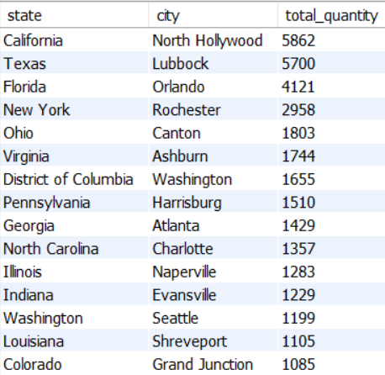
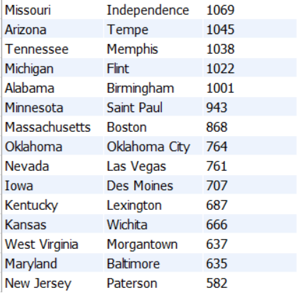
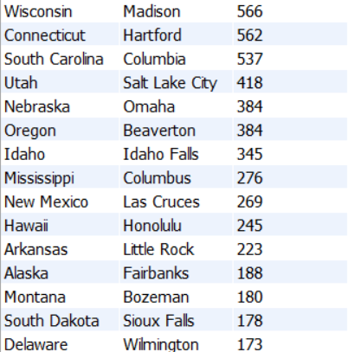
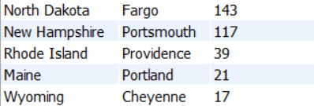
# Q 21. Can you identify any patterns in sales based on the time of year?
Sales in September, October & November is highest then other months.
# Q 22. Are there any significant geographical trends in sales?

Slide 20
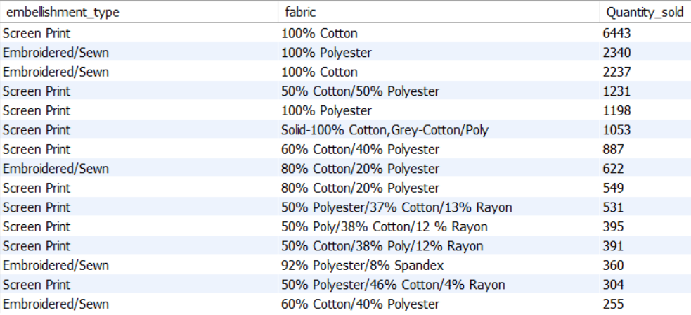
# Q 23. Can you identify any outliers in the sales data?
We can find outliers using Z-score method.
The Formula for Z-Score method is :- (value-mean)/standard deviation.
The threshold limit for z-score is between -3 & 3. If the z-score is less than -3 or more than 3 then it is an outlier and the z-score between -3 & 3 is not an outlier.
There are 459 values which falls above 3 and below -3.
# Q 24. Is there a relationship between product attributes (e.g., fabric, embellishment type) and sales performance?
There are 148 different Embellishment type which were sold, but top 15 most sold fabric with other embellishment types are :-

Slide 21
# Q 25. Can you identify any seasonality effects in sales data?

Slide 23
In Year wise, Sales data we can clearly see that in all months Basic Non-Seasonal has made the most number of sales. Hence displaying Basic Non-Seasonal sales in Overall Months.
The sales of Basic Non-Seasonal category of products are highest in July, September & November.

Slide 24
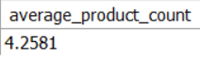
# Q 26. What is the average number of products purchased per wholesale order?
Average Number of Products purchased per wholesale order is 4.2581 i.e 4.
# Q 27. Can you segment customers based on their purchasing behavior?

Slide 25
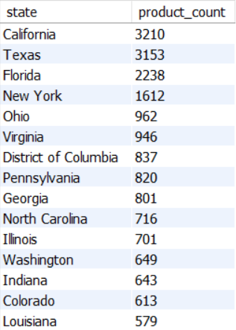
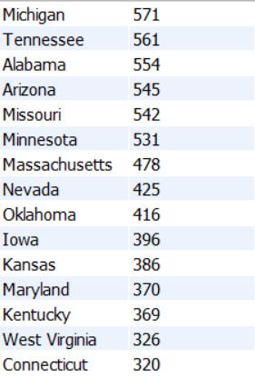
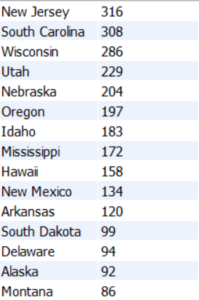
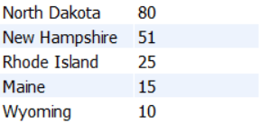
# Q 28. Is there a relationship between customer demographics and the products they purchase?

Slide 26
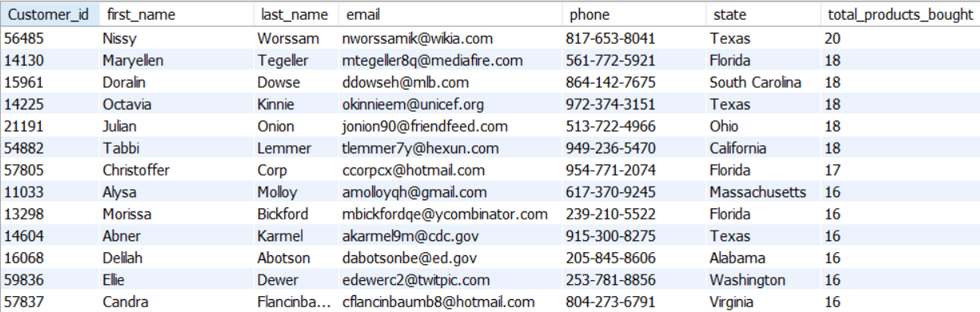
Customers that have brought more than 15 products are :-
These are the customer along with their information who brought more than 15 products. Suggestion to increase the buying products by customer is by offering then discounts or coupon codes so they can purchase products in more quantity. We can simply inform the marketing team to inform customers through email or phone call and make them aware of on-going discounts and offers.

Slide 27
The End.
Thank You.
Tools Used -
MySQL
Microsoft PowerPoint
Sreerag. S

